Slide 1
Crash course: Apache MXNet with Gluon
Sergey Sokolov
20 Sep 2018

Slide 2
Why MXNet?
Flexible & Debugable
Scalable
Portable

Slide 3
Quick History
Since 2015

Slide 4
Originated from DMLC
& many more…
Distributed Machine Learning Community
XGBoost
MinPy
MXNet

Slide 5
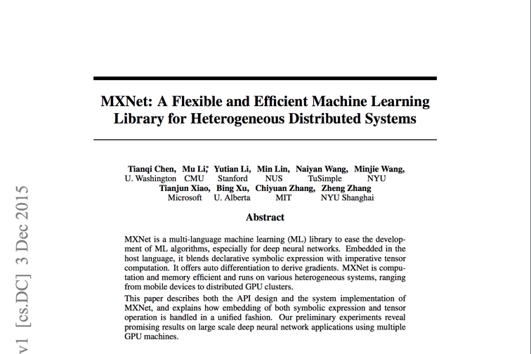
Original Paper in 2015
https://arxiv.org/pdf/1512.01274.pdf

Slide 6
Major Events
Amazon’s deep-learning framework of choice
since November 2016.
Accepted into
Apache Incubator
in January 2017.

Slide 7

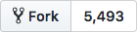
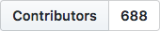
Highlights
Ease of Use
Flexible APIs
Performance
Optimized for CPU, GPU, ARM (and more)
Python, Scala, R, C++, Clojure, Julia, Perl
Examples and tutorials
Portability
Train on cloud, predict on edge
Highly scalable distributed training
ONNX support
Quantization, Sparse, NCCL, and more…
Model serving framework

Slide 8
Architecture

Slide 9
Multi-language Support
While keeping high performance from efficient backend
R
Perl
Julia
Clojure
Python
Scala
C++
Frontend
Backend
C++

Slide 10
Optimized libraries
CUDA & CUDNN
MLK, MKLML & MKLDNN
e.g. pip install mxnet-cu92
e.g. pip install mxnet-mkl
e.g. pip install mxnet-cu92mkl
Also Atlas, OpenBLAS & Apple Accelerate.

Slide 11
Asynchronous Engine
Sync
Async
Operations appear to return immediately, but just pushed to engine queue on backend.
Allows for much greater parallelism.
Serial or parallel? “The execution of any two functions when one of them modifies at least one common variable is serialized in their push order.”
Must wait_to_read() or similar to retrieve value and this blocks.
backend
frontend
wait_to_read()

Slide 12
Python Core APIs
Module
(2016)
Gluon
(2017)
High Level APIs
Symbol
NDArray
Low Level APIs
Notes:
Used to be Model, but deprecated.

Slide 13
Ecosystem & Community

Slide 14
Ecosystem
ONNX
Model Zoo
TVM
GluonCV
MXNet
Model Server
GluonNLP
MXBoard
Keras
Notes:
Model Zoo (Module, Gluon & ONNX)

Slide 15

Community
http://mxnet.io
http://discuss.mxnet.io
https://github.com/apache/incubator-mxnet
/apachemxnet
@ApacheMXNet
@ApacheMXNet
/r/mxnet

Slide 16
Demo

Slide 17
Additional resources
Deep Learning - The Straight Dope
https://gluon.mxnet.io/
Deep Learning Toolkit for NLP
http://gluon-nlp.mxnet.io/
Deep Learning Toolkit for CV
https://gluon-cv.mxnet.io/
Various models
https://github.com/chinakook/Awesome-MXNet

Slide 18
How to Get Started with MXNet on AWS
Amazon SageMaker: https://aws.amazon.com/sagemaker/
Using Apache MXNet with Amazon SageMaker: https://docs.aws.amazon.com/sagemaker/latest/dg/mxnet.html
Contact: mxnet-info@amazon.com

